Slide 1
Matsu Update
Open Cloud Consortium / Open Data
August 2012

Slide 2
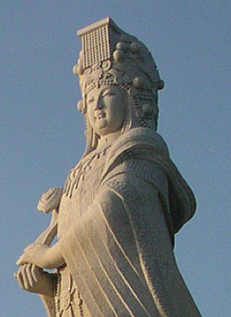
Project Matsu
Open Source
Cloud-based infrastructure
Public satellite image data (Earth Observing-1)
Open Geospatial Compliant Web Map Service
Intended for human-aided disaster relief

Slide 3
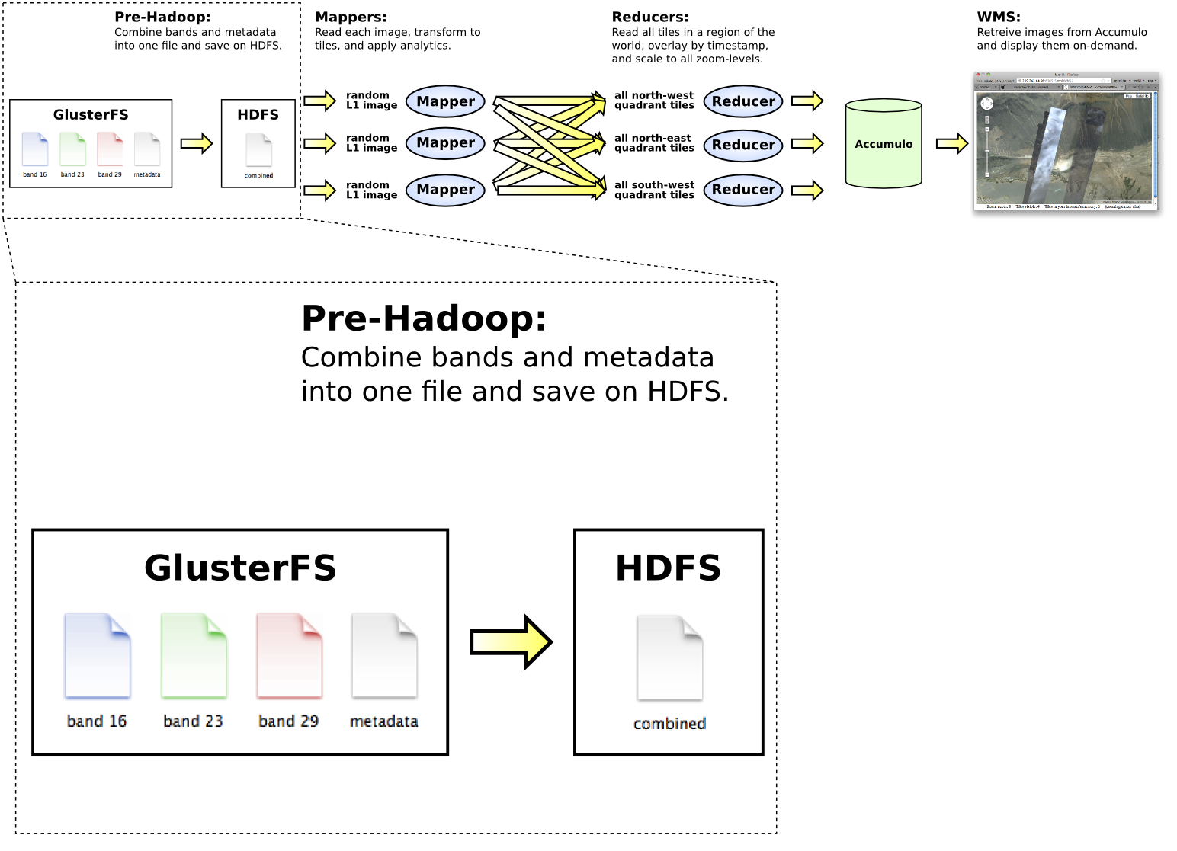
Tiling procedure in detail

Slide 4
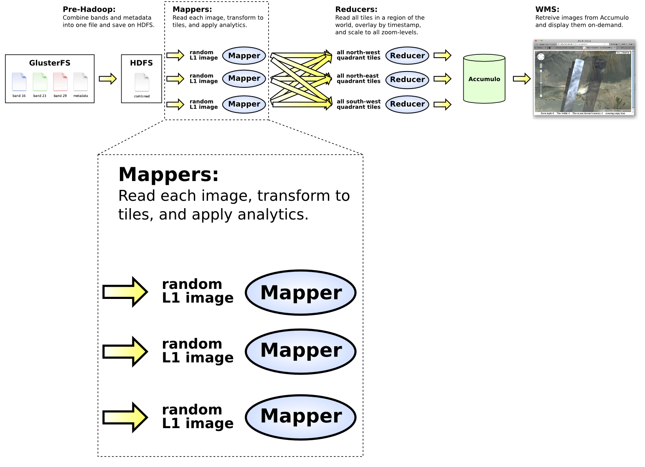
Tiling procedure in detail

Slide 5
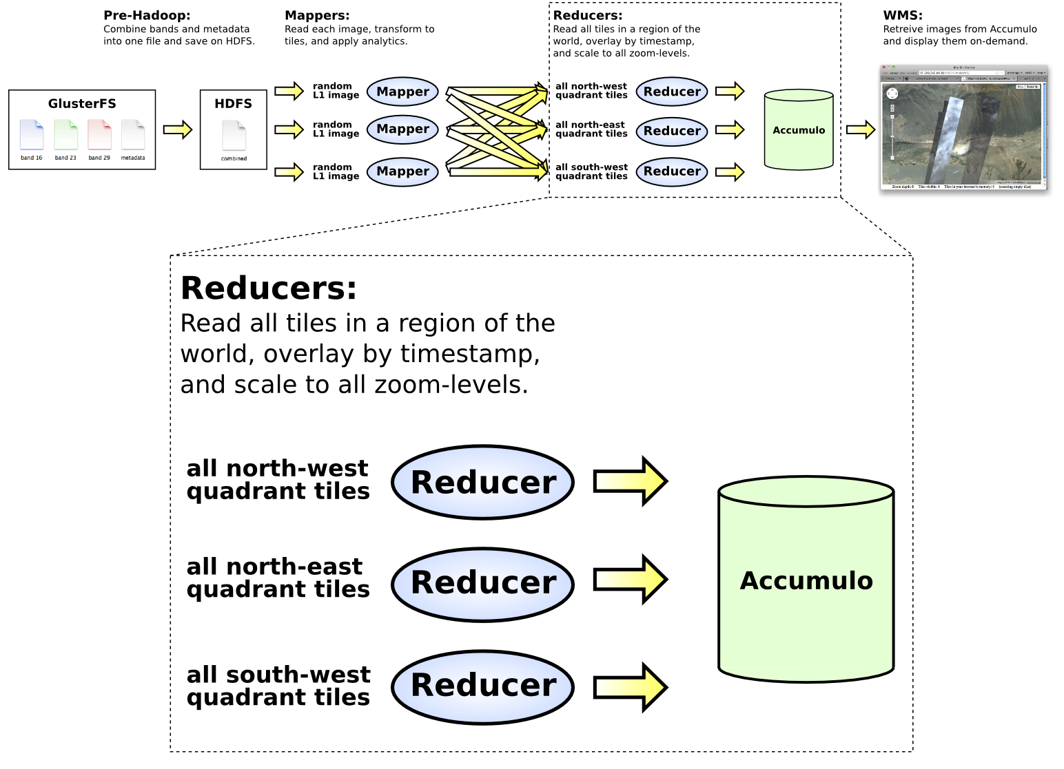
Tiling procedure in detail

Slide 6
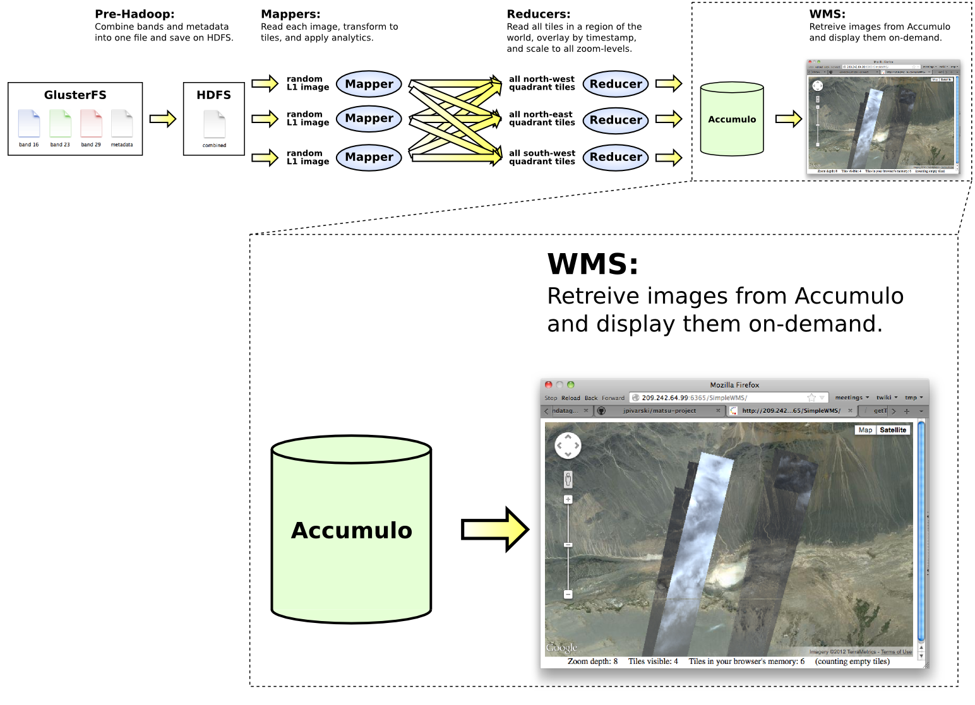
Tiling procedure in detail

Slide 7
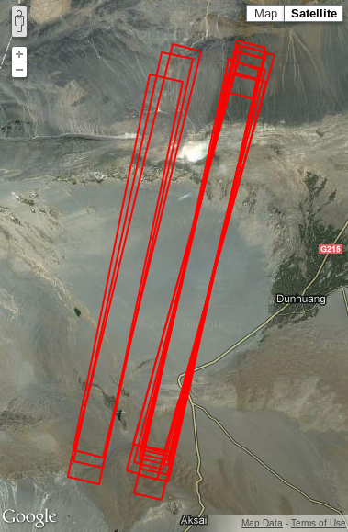
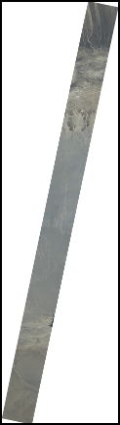
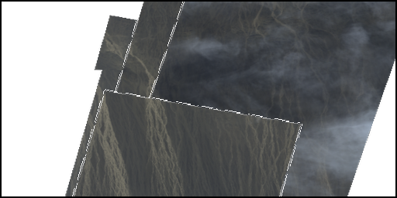
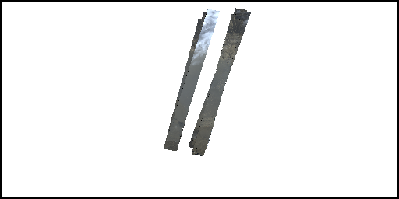
Images at each stage of processing
T10-01561-01486
T06-00097-00092
image locations
L1R
L1G
Level-2 tiles at two zoom levels
NASA produces L1R (raw) and L1G (geo)
L1G is in an equal-area projection, our map step transforms to an equal-degree projection to fit into degree-based tiles
All processing (coordinate transformation and analysis) is performed on the deepest zoom level (T10)

Slide 8
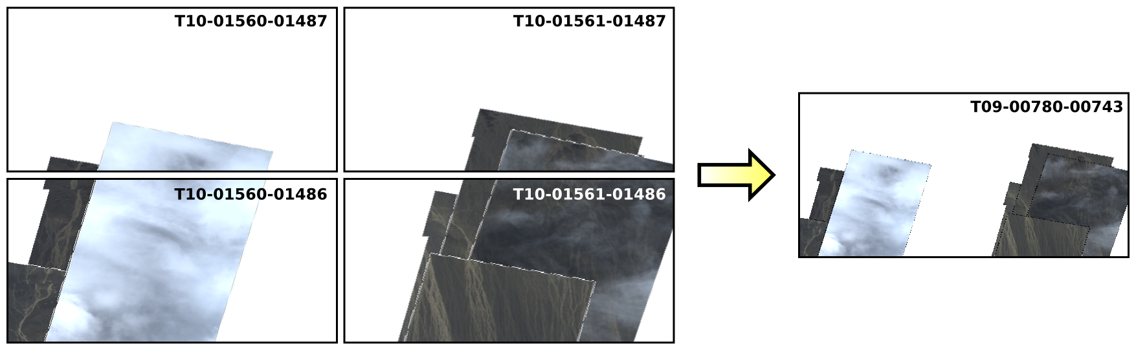
Building zoomed-out images
Reduce step overlays tiles and builds zoomed-out images
Four neighboring tiles are combined and shrunken to decrease by one zoom level
Process continues until one image covers the entire region that the reducer is responsible for (e.g. 1/2^{N}th of the world)
Tdepth-lngIndex-latIndex
parent is depth−1, lng/2, lat/2

Slide 9
Implementation details
Hadoop mappers and reducers are written in Python
Geospatial Data Abstraction Library (GDAL) interprets geolocation data and feeds images into NumPy arrays
NumPy/SciPy transform and analyze images
Python Imaging Library (PIL) creates PNG output
A compiled Python extension, based on Avro-C++, serializes the images and metadata to be passed through Hadoop
JPype feeds image data into the Java-based Accumulo interface
Any new analytics in C/C++ can be compiled into Python extensions
Any new analytics in Java can be accessed through Jpype
Any new analytics in R can be accessed through RPy
Accumulo interface is written in Java (fed by JPype)
WMS runs as a Java-based servlet in JBoss

Slide 10
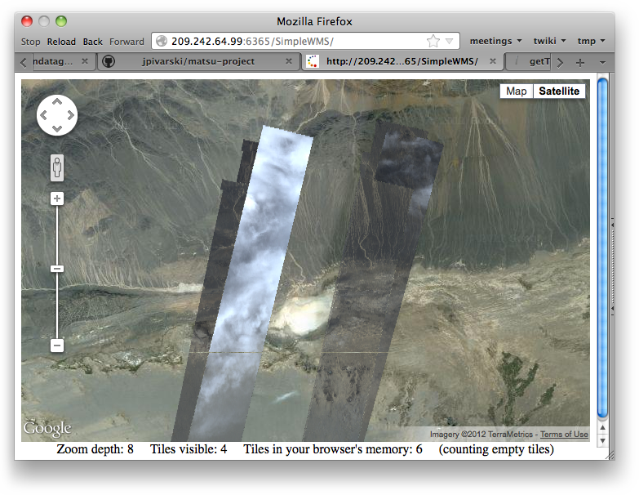
Accumulo → WMS demo (GramTel)
http://jboss-server:port/SimpleWMS
http://jboss-server:port/TileServer/getTile?key=T06-00097-00092-RGB

Slide 11
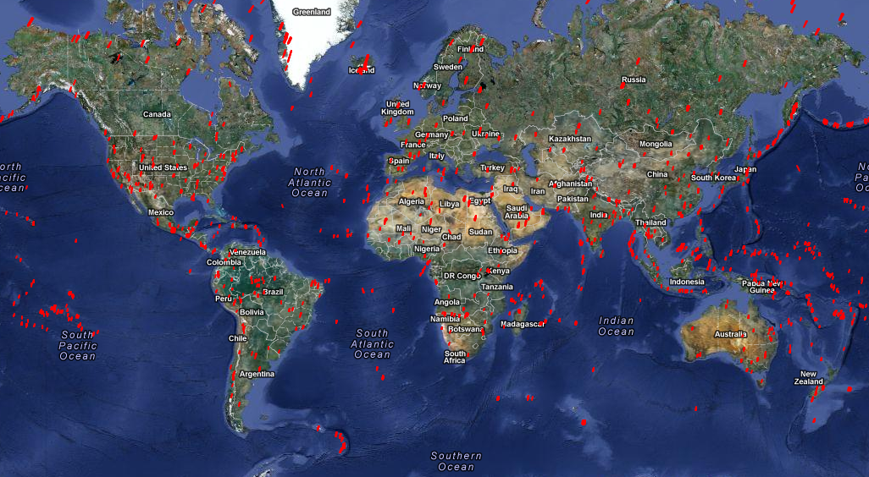
Analysis: all available L1G images
http://jboss-server/available.php
Notes:
This URL is the one I gave you by e-mail. Now it’s in the slides.

Slide 12
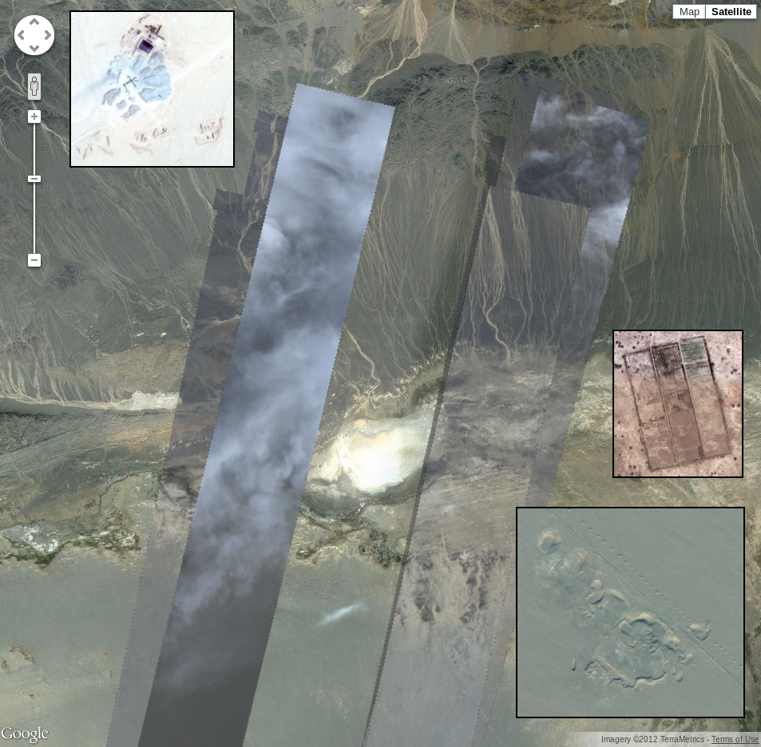
Example images
Gobi Desert
dry riverbeds test geo-location
contains some strange objects to look for spectrally (too small to find spatially)
used in most end-to-end workflow tests
(background is Google Maps)

Slide 13
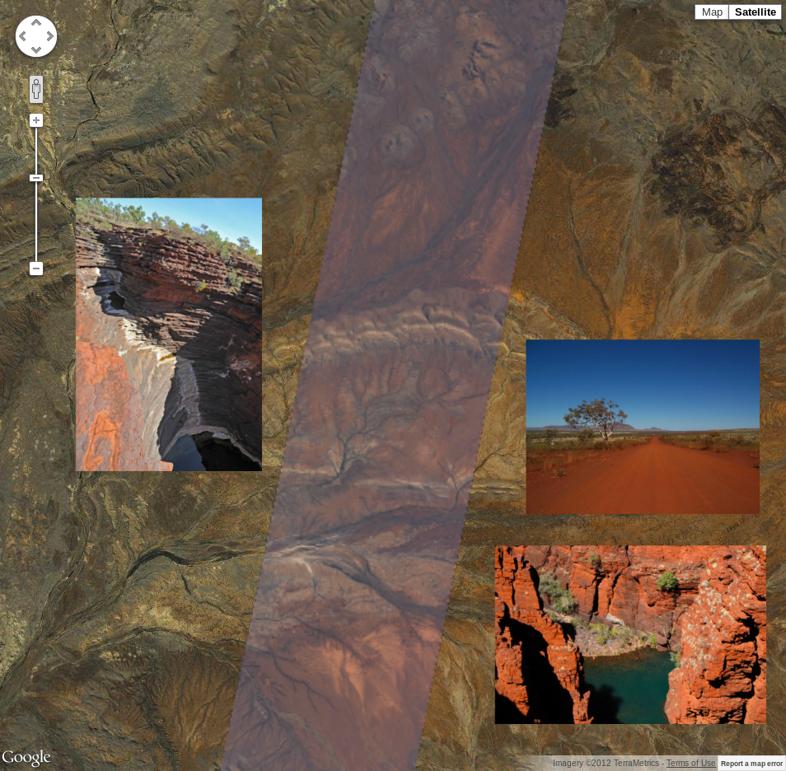
Example images
Karijini, Australia
lots of colorful minerals
should have rich structure in its spectrum that varies from pixel to pixel
(background is Google Maps)

Slide 14
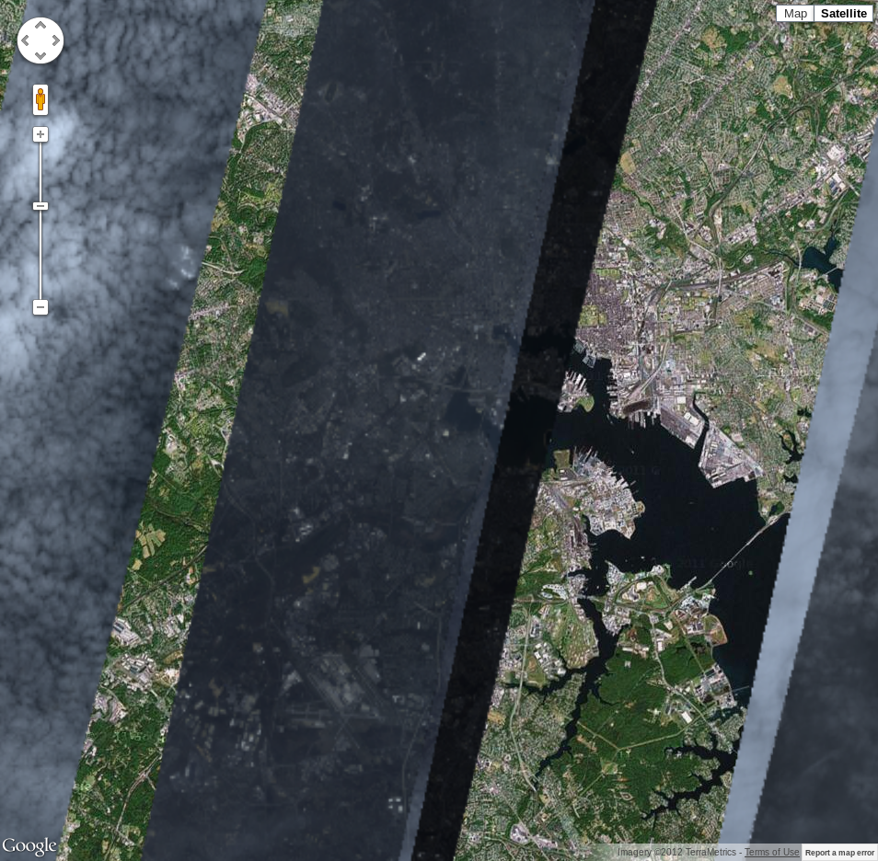
Example images
Baltimore
city view
could have some artificial features in its spectrum
(background is Google Maps)

Slide 15
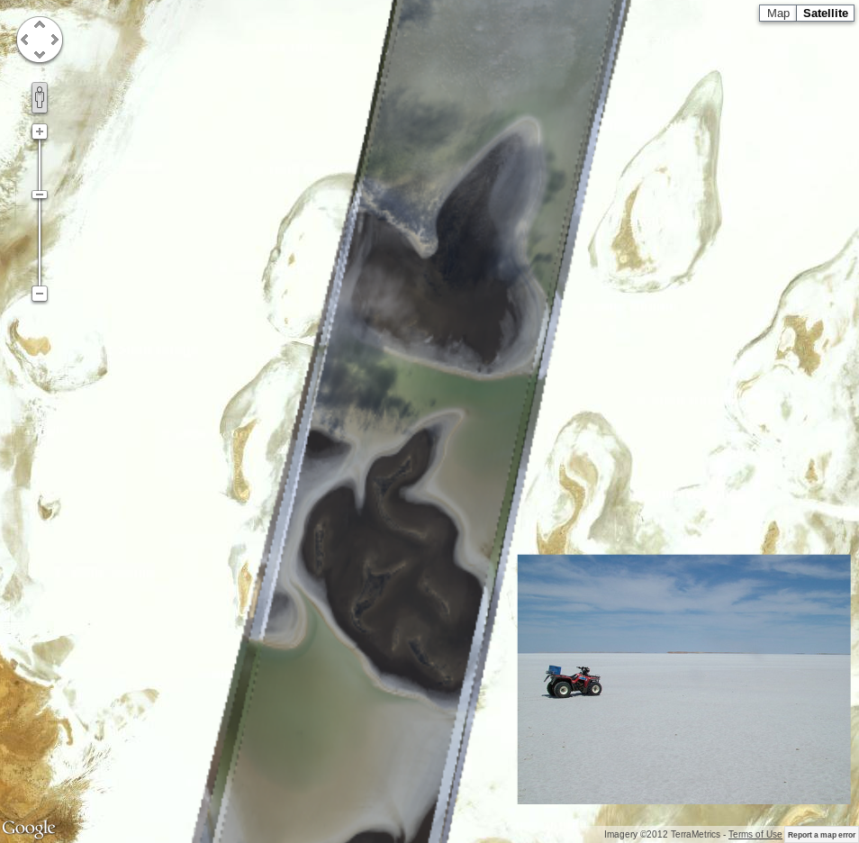
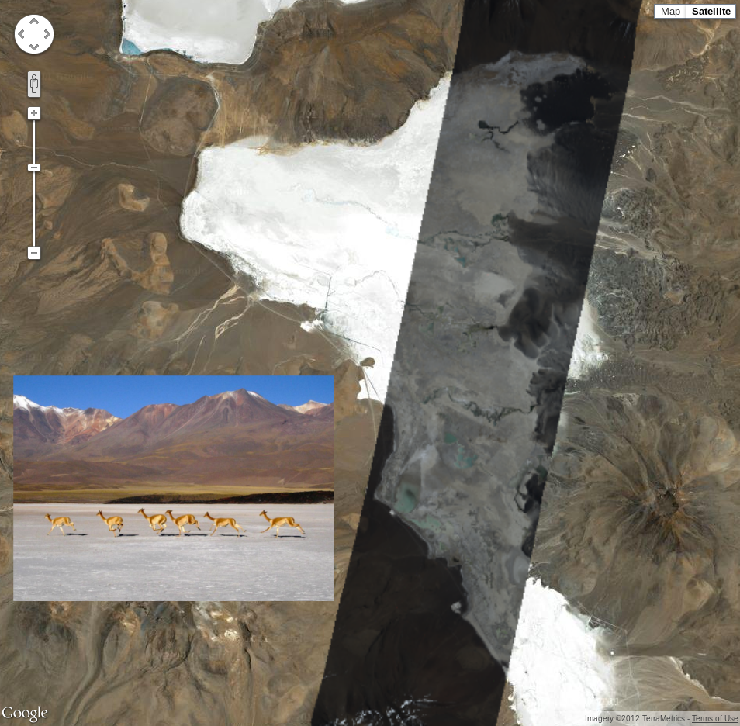
Example images uploaded
Lake Frome, Australia
salt bed is a well-known calibration target
Atacama Desert, Chile
another salt bed in the driest part of the world
(background is Google Maps)

Slide 16
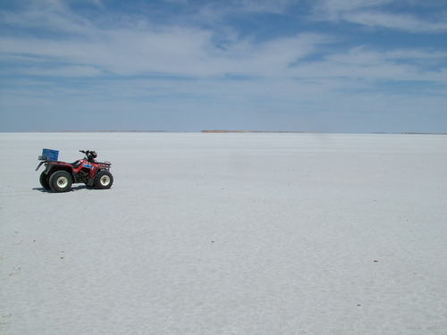
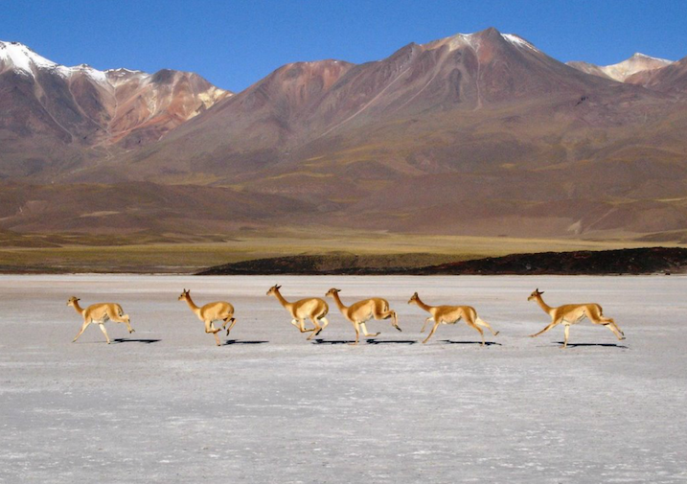
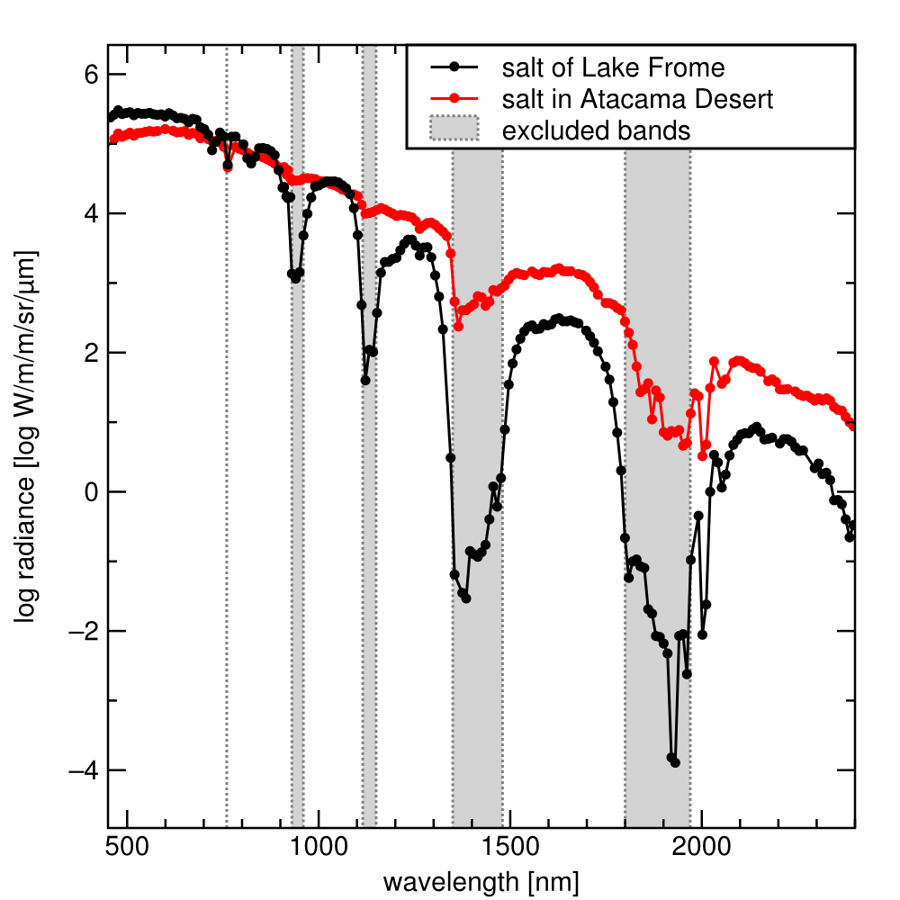
Analysis of full spectrum in a small spatial region (salt beds)
Lake Frome, Australia
Atacama Desert, Chile
Much less water vapor absorbtion in Atacama, as expected
NASA recommends excluding water vapor bands from classification algos

Slide 17
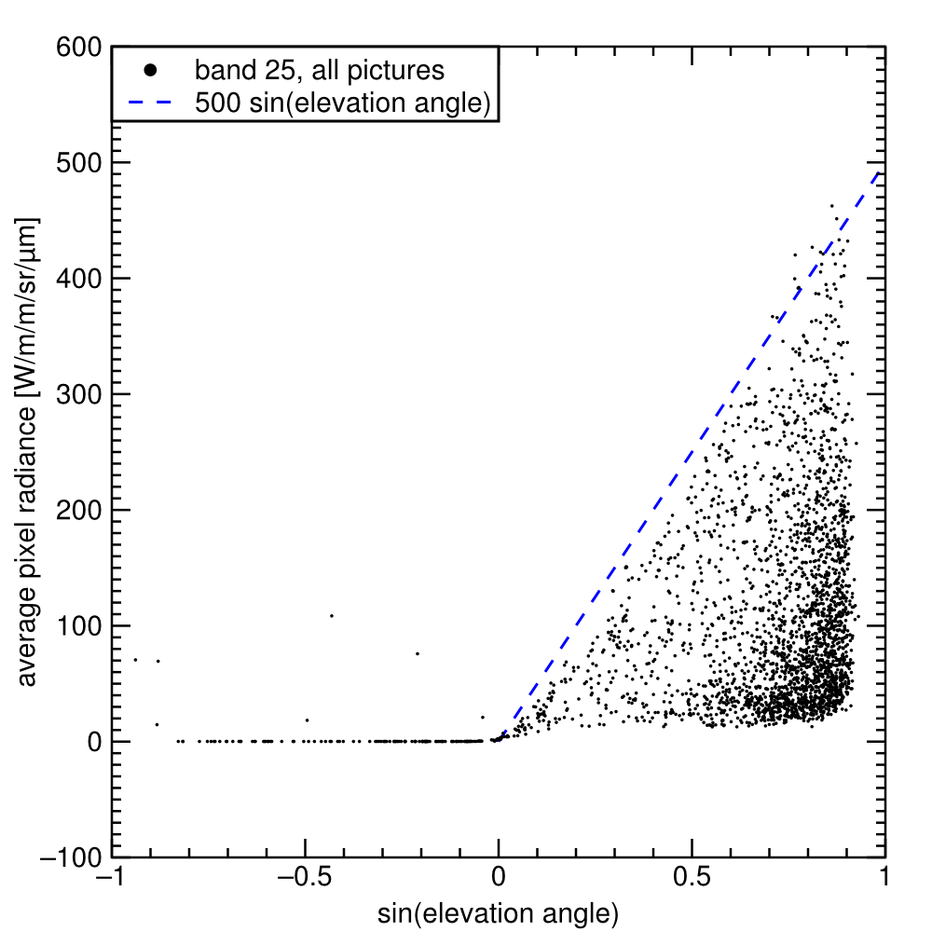
Analysis of many images: brightness versus sun elevation
Analysis of all historical images (each data point is an L1G image)
Vertical axis: average pixel radiance
Horizontal axis: elevation of the sun (metadata)
Can be used to remove time-of-day dependence in classification algos
night
day

Slide 18
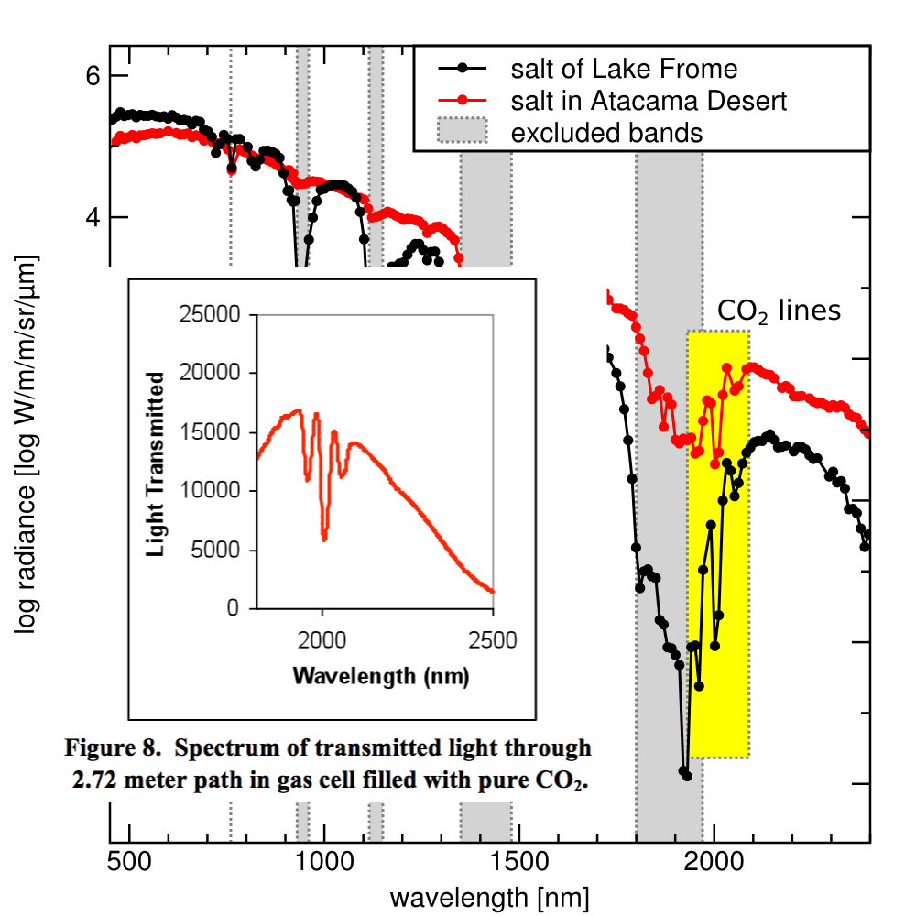
Algebraic combination of spectral bands to make a more sensitive image
CO₂ has three absorbtion lines within Hyperion’s spectral range
Sideband subtraction technique extracts a pure sample of data in a peak by fitting nearby datapoints to a curve and subtracting peak values from the curve
In this case, we invert the subtraction because it’s an anti-peak
External
Reference

Slide 19
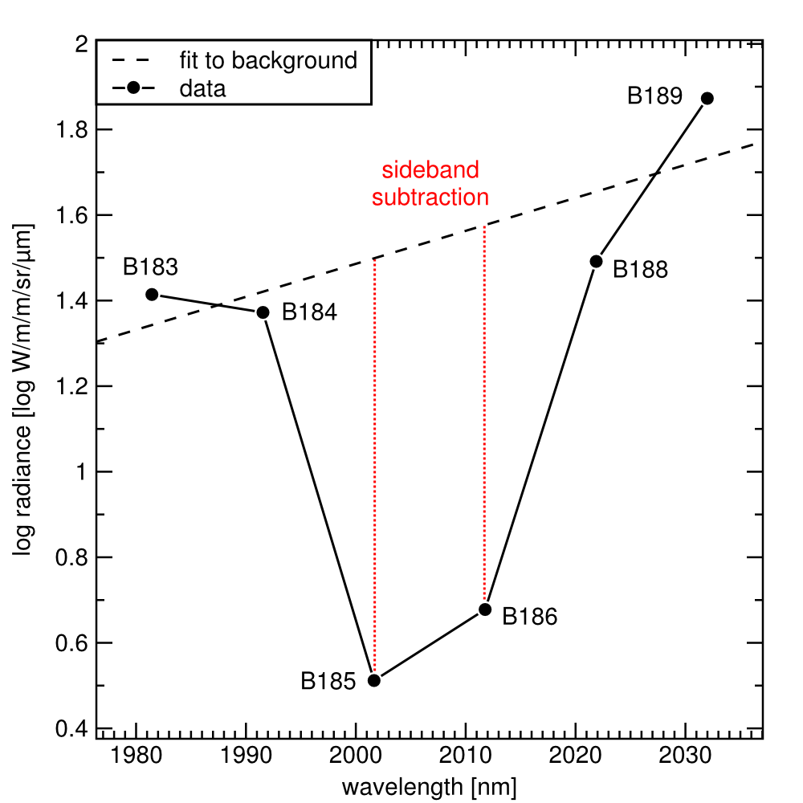
Algebraic combination of spectral bands to make a more sensitive image
CO₂ has three absorbtion lines within Hyperion’s spectral range
Sideband subtraction technique extracts a pure sample of data in a peak by fitting nearby datapoints to a curve and subtracting peak values from the curve
In this case, we invert the subtraction because it’s an anti-peak
two bands in
the CO₂ line

Slide 20
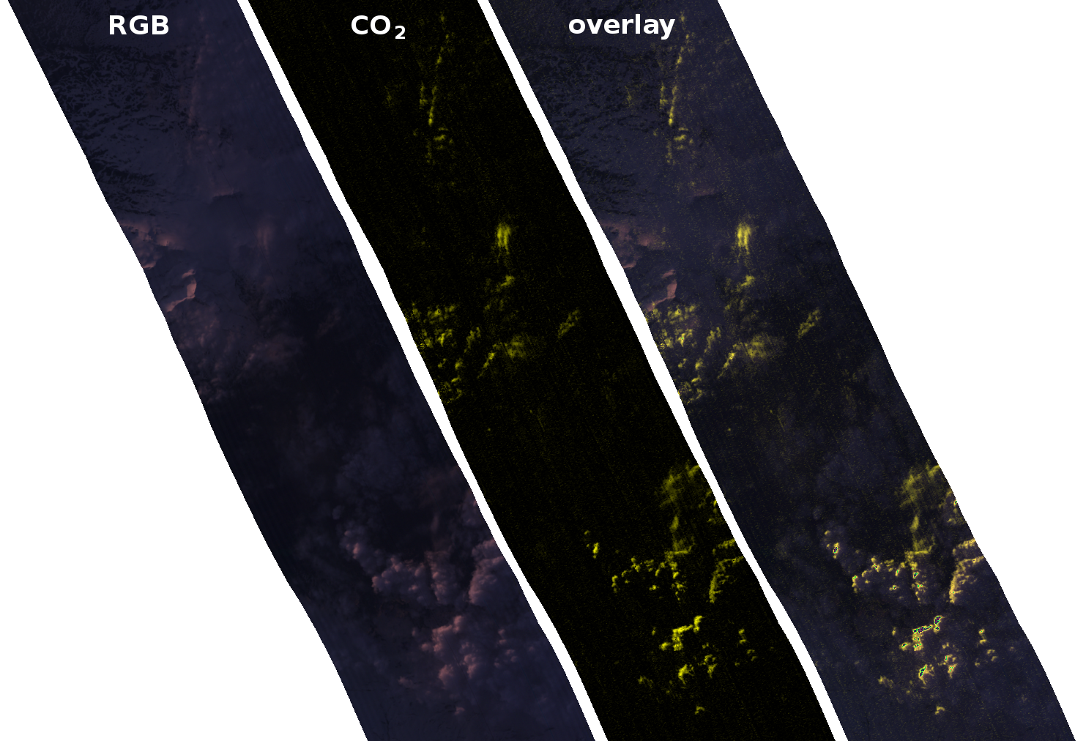
Algebraic combination of spectral bands to make a more sensitive image
Some CO₂ activity follows visible cloud formations, some doesn’t
Icelandic volcano in April 2010 (Eyjafjallajökull)
Visible frame is full of ash clouds
CO₂ distribution is non-uniform

Slide 21
Algebraic combination of spectral bands to make a more sensitive image
Some CO₂ activity follows visible cloud formations, some doesn’t
Python code used to produce this image (vectors in bold):
sum1 = 4.
sumx = 183. + 184. + 188. + 189.
sumxx = 183.**2 + 184.**2 + 188.**2 + 189.**2
sumy = B183 + B184 + B188 + B189
sumxy = 183.*B183 + 184.*B184 + 188.*B188 + 189.*B189
delta = sum1*sumxx - sumx**2
constant = (sumxx*sumy - sumx*sumxy) / delta
linear = (sum1*sumxy - sumx*sumy) / delta
subtracted = (B185 - (constant + 185.*linear))/2. +
(B186 - (constant + 186.*linear))/2.
Icelandic volcano in April 2010 (Eyjafjallajökull)
Visible frame is full of ash clouds
CO₂ distribution is non-uniform

